Slide 1
CSC 551: Web Programming
Spring 2004
Internet & World Wide Web Protocols
  network layers
  TCP/IP
    domain name system, IP addresses, routing protocols
  HTTP
    GET/POST, headers, caching, cookies

Slide 2
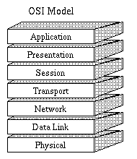
OSI 7-layer model
in the 70's, computer networks were ad hoc, vendor-specific
Open Systems Interconnection model
  developed by the ISO in 1984
  provides an abstract model of networking
  divides the tasks involved in moving info
    between networked computers into 7 task groups
  each task group is assigned a layer
Each layer is reasonably self-contained, so
  can be implemented independently
  changes/updates to a layer need not effect other layers

Slide 3
Protocol layers
Application layer
  describes how applications will communicate
  e.g., HTTP, FTP, Telnet, SMTP
Presentation layer
  describes the form of data being transferred & ensures that it will be readable by receiver
  e.g., floating point formats, data compression, encryption
Session layer
  describes the organization of large data sequences & manages communication session
  e.g., coordinates requests/responses
Transport layer
  describes the quality and nature of data delivery
  e.g., how retransmissions are used to ensure delivery
Network layer
  describes how a series of exchanges over various data links can deliver data across a network
  e.g., addressing and routing
Data Link layer
  describes the logical organization of data bits transmitted on a particular medium
  e.g., frame sequencing, error notification
Physical layer:
  describes the physical & electrical properties of the communications media
  e.g., voltage levels, data rates, max distances

Slide 4
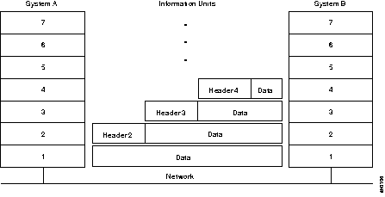
Layer protocols
across the network, processes at the same level can (seemingly) communicate
  e.g., Web server & browser run at the application level, communicate via HTTP
in reality, actual communication takes place at the physical layer
  upper layers can only communicate with those above and below
  at the source, as data is passed down the layers:
    the protocol for each layer adds control information to the data
  at the destination, as data is passed up the layers:
    the protocol for each layer strips and analyzes the control information for that layer

Slide 5
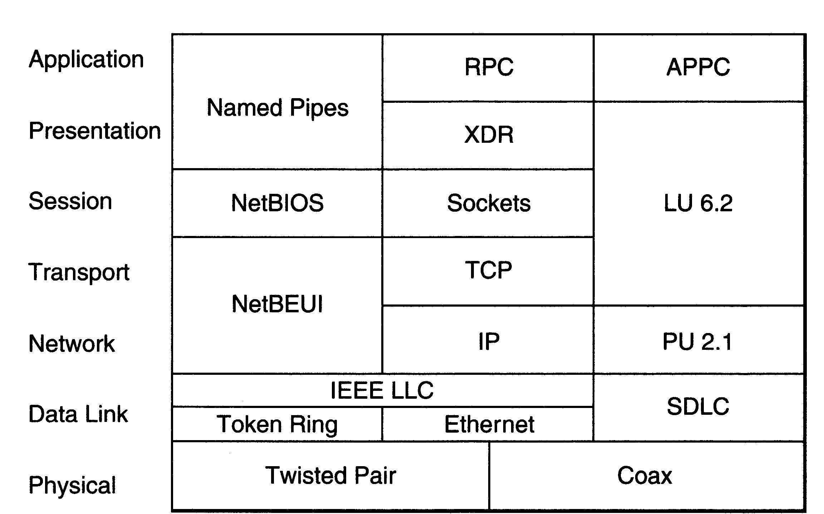
Internet protocol suite
Network layer: Internet Protocol (IP)
  provides generalized packet network interface
  handles routing through the Internet
  connectionless and unreliable
Transport layer: Transmission Control Protocol (TCP)
  provides a virtual circuit over which two processes can communicate
  supplies logic to give reliable, connection-oriented session
  FTP (file transfer) and HTTP are built on top of TCP

Slide 6
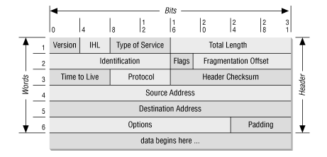
Internet Protocol (IP)
the IP protocol adds packet routing info (20 bytes)
Time-to-live (TTL):
  indicates number of hops packet is allowed to take before being discarded
Source address:
  IP address of host sending the packet
Destination address:
  IP address of host to receive the packet
Options:
  options such as sender-specified routing or security

Slide 7
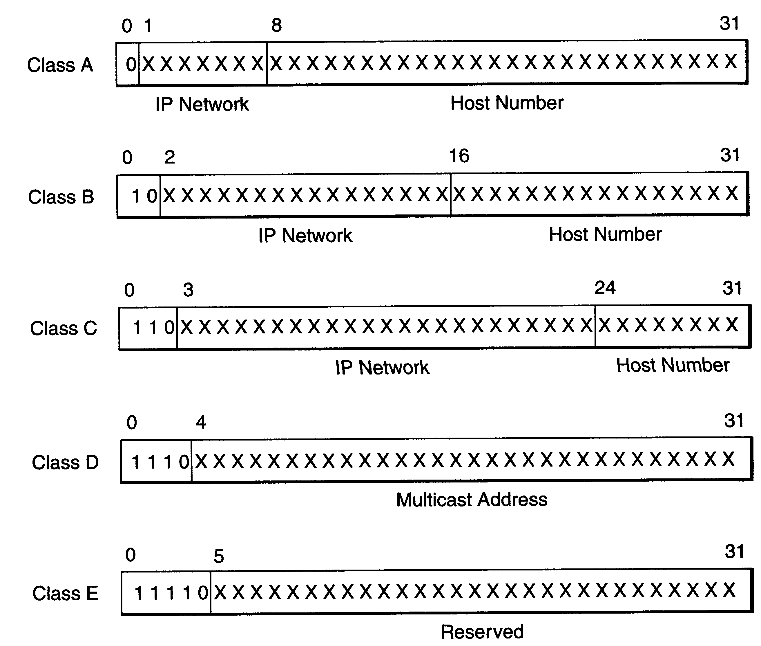
IP addresses
IP addresses are 32 bits long
  10010011 10000110 00000010 00010100
  ↓ written as a dotted sequence
  147.134.2.20
divided into 5 classes
  class A: start with 0, then 7-bit code
    2²⁴ = 16,777,216 hosts in subnetwork
  class B: start with 10, then 14-bit code
    2¹⁶ = 65,536 hosts in subnetwork
  class C: start with 110, then 21-bit code
    2⁸ = 256 hosts in subnetwork
  class D: start with 1110
    used for multicasting
  class E: start with 11110
    reserved for future use
IPv6 extends address size to 128 bits
  extensions support authentication, data integrity, confidentiality

Slide 8
Domain name system
rarely do applications deal directly with IP addresses
  a hierarchical system of domain names can be used instead
  top level domains: edu, com, gov, org, net, …
  commonly: hostname.subdomain.domain (possibly many subdomains)
  e.g., bluejay.creighton.edu
a domain name server (DNS) is a machine that keeps a table of names and corresponding IP addresses
  there are 13 root servers in the world (mirrored)
  when an application specifies a host name,
    go to local domain name server and try lookup
    if not stored there, then local DNS requests address from a root server
    root server determines appropriate name server & forwards request

Slide 9
Routing protocols
routers (or gateways) are special purpose machines on the Internet that determine the path for packets from source to destination
  when a router receives a packet, inspects the destination address
  looks up that address in a routing table
  based on the contents of the table, forwards the packet to another router (or to its final destination if possible)
Routing Information Protocol (RIP)
  describes how routers exchange routing table information
  uses hop-count as the metric of a path's cost
Open Shortest Path First Protocol (OSPF)
  more robust, scalable protocol than RIP
  doesn't exchange entire tables, only updates changed links
Internet Control Message Protocol (ICMP)
  adjunct to IP, notifies sender (or other router) of abnormal events
    e.g., unreachable host, net congestion

Slide 10
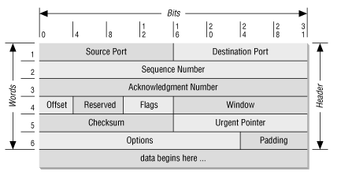
Transmission Control Protocol (TCP)
the TCP protocol adds info for providing a virtual circuit, including message formatting, circuit management, flow control, error correction
Source & destination ports
  a port is analogous to a mailbox
Sequence number:
  identifies its place in sequence
  (byte # in overall message)
Acknowledgement number:
  specifies the next byte # in sequence,
  if destination does not receive it in X amount of time, will notify sender
Control flags:
  used to set up connection (3-way handshake: request, ack, ack),
  mark as urgent, terminate connection, …

Slide 11
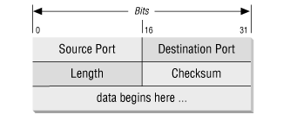
User Datagram Protocol (UDP)
UDP protocol is a simple, connectionless alternative to TCP
  used in many Internet applications that require only simple query/response
  e.g., time
Source & destination ports
  same as in TCP
Length:
  number of bytes in the packet
Checksum:
  rudimentary error detection

Slide 12
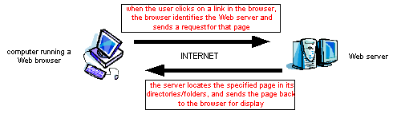
World Wide Web
the Web is the world’s largest client/server system
  communication occurs via message passing
    within browser, select URL of desired page
    browser requests page from server
    server responds with message containing
      type of page (HTML, gif, pdf, zip, …)
      page contents
    browser uses type info to correctly display page
    if page contains other items (images, applets, …),
      browser must request each separately

Slide 13
HTTP
Hypertext Transfer Protocol (HTTP):
  application-level protocol for distributed, collaborative, hypermedia information systems
  generic, stateless, object-oriented
  can be used for many tasks, such as name servers & distributed object management systems
  underlying language of the Web
HTTP/1.0 allowed only connectionless message passing
  each request/response required a new connection
  to download a page with images required multiple connections
    can overload the server, require lots of overhead
HTTP/1.1 provides persistent connection by default
  once client & server connect, remains open until told to close it (or timeout)
    reduces number of connections, saves overhead
  client can send multiple requests without waiting for responses
    e.g., can request all images in a page at once

Slide 14
GET request
most URL’s have the form: protocol://serverName URI
  e.g., http://www.creighton.edu/~davereed/index.html
to retrieve a document via HTTP from the server, issue a GET request
GET URI HTTP/1.1
Host: serverName
Web server only knows the contents of the GET request message
  automatically generated by browser when you select a URL
  could also come from a link checker, a search engine robot, …
  can come directly from a telnet connection using port 80

Slide 15
GET example
HTTP/1.1 200 OK
Date: Thu, 22 Jan 2004 18:35:24 GMT
Server: Apache/1.3.27 (Unix) PHP/4.1.2
Last-Modified: Tue, 13 Jan 2004 17:38:00 GMT
ETag: "155005-1a4-40042cf8"
Accept-Ranges: bytes
Content-Length: 420
Content-Type: text/html
<HTML><HEAD><TITLE>Dave Reed's Home Page</TITLE>
<!--- Dave Reed index.html 10/5/00 -->
<!--------------------------------------------------->
<SCRIPT language=JavaScript>
if (self!=top) top.location.href=self.location.href;
</SCRIPT>
</HEAD>
<FRAMESET border=0 cols="175,*">
<FRAME name="menu" src="menu.html" />
<FRAME name="main" src="info.html" />
</FRAMESET>
</HTML>
bluejay> telnet www.creighton.edu 80
Trying...
Connected to swift.creighton.edu.
Escape character is '^]'.
GET /~davereed/index.html HTTP/1.1
Host: www.creighton.edu
server response has assorted header information, followed by the page

Slide 16
Response header fields
the first line of the server’s response contains a status code
  200 OK request was processed successfully
  301 Moved permanently document has been moved
  304 Not modified if cached version is up-to-date
  400 Bad request syntax error in client’s request
  403 Forbidden client is not allowed access (e.g., protected)
  404 Not found file could not be found
  500 Internal server error server failed
  503 Service unavailable server is overloaded

Slide 17
Other response header fields
in addition to the status code, the server’s response may include
  Date response time (in GMT)
  Server identification info on the server
  Last-modified time document was last changed (in GMT)
  Content-length size of document, in bytes
  Content-type file format (e.g., html, gif, pdf)
  Expires prevents browser from caching beyond date

Slide 18
File not found
HTTP/1.1 404 Not Found
Date: Thu, 22 Jan 2004 18:37:29 GMT
Server: Apache/1.3.27 (Unix) PHP/4.1.2
Content-Type: text/html
<head>
<META HTTP-EQUIV=refresh CONTENT="50;URL=http://www.creighton.edu/">
<title>Requested Page Not Found!</title>
</head>
<body bgcolor=white>
<font face="Arial">
<h1>Requested Page Not Found!</h1>
<hr>
<p><b>
The URL you requested was not found on <a
href="http://www.creighton.edu">this server</a>. (Error 404)
</p>
<p>
.
.
.
bluejay> telnet www.creighton.edu 80
Trying...
Connected to swift.creighton.edu.
Escape character is '^]'.
GET /~davereed/foo.html HTTP/1.1
Host: www.creighton.edu
if file not found, response includes 404 status code and generic error page

Slide 19
Directories as URI’s
HTTP/1.1 200 OK
Date: Thu, 22 Jan 2004 18:41:17 GMT
Server: Apache/1.3.27 (Unix) PHP/4.1.2
Last-Modified: Tue, 13 Jan 2004 17:38:00 GMT
ETag: "155005-1a4-40042cf8"
Accept-Ranges: bytes
Content-Length: 420
Content-Type: text/html
<HTML><HEAD><TITLE>Dave Reed's Home Page</TITLE>
<!--- Dave Reed index.html 10/5/00 -->
<!--------------------------------------------------->
<SCRIPT language=JavaScript>
if (self!=top) top.location.href=self.location.href;
</SCRIPT>
</HEAD>
<FRAMESET border=0 cols="175,*">
<FRAME name="menu" src="menu.html" />
<FRAME name="main" src="info.html" />
</FRAMESET>
</HTML>
bluejay> telnet www.creighton.edu 80
Trying...
Connected to swift.creighton.edu.
Escape character is '^]'.
GET /~davereed/ HTTP/1.1
Host: www.creighton.edu
if a directory is specified, will look for a file named index.html

Slide 20
Redirection
HTTP/1.1 301 Moved Permanently
Date: Thu, 22 Jan 2004 18:42:53 GMT
Server: Apache/1.3.27 (Unix) PHP/4.1.2
Location: http://www.creighton.edu/~davereed/
Transfer-Encoding: chunked
Content-Type: text/html; charset=iso-8859-1
166
<!DOCTYPE HTML PUBLIC "-//IETF//DTD HTML 2.0//EN">
<HTML><HEAD>
<TITLE>301 Moved Permanently</TITLE>
</HEAD><BODY>
<H1>Moved Permanently</H1>
The document has moved <A HREF="http://www.creighton.edu/~davereed/">here</A>.<P
>
<HR>
<ADDRESS>Apache/1.3.27 Server at <A HREF="mailto:webmaster@creighton.edu">www.cr
eighton.edu</A> Port 80</ADDRESS>
</BODY></HTML>
0
bluejay> telnet www.creighton.edu 80
Trying...
Connected to swift.creighton.edu.
Escape character is '^]'.
GET /~davereed HTTP/1.1
Host: www.creighton.edu
since URI is missing / at end, browser must do 2 requests

Slide 21
Request header fields
the client can specify additional information in the request
  User-Agent specifies the browser version
  Referer tells server where the user came from
  useful for logging and customer tracking
  From contains email address of user
  generally not used for privacy reasons
  Authorization can send username & password
    used with documents that require authorization
  If-Modified-Since only send document if newer than specified date
    used for caching

Slide 22
Conditional GET
bluejay> telnet www.creighton.edu 80
Trying...
Connected to swift.creighton.edu.
Escape character is '^]'.
GET /~davereed/ HTTP/1.1
Host: www.creighton.edu
If-Modified-Since: Wed, 21 Jan 2004 14:00:00 GMT
HTTP/1.1 304 Not Modified
Date: Thu, 22 Jan 2004 18:45:25 GMT
Server: Apache/1.3.27 (Unix) PHP/4.1.2
ETag: "155005-1a4-40042cf8"
since the document has not been modified since the specified date, the page is not sent by the server (status code 304)

Slide 23
Other request methods
HEAD similar to GET, but requests header information only
useful for checking to see if a document exists, how recent
POST similar to GET, but encodes inputs differently
useful for submitting form contents to a CGI program
PUT upload a document to the server
new in HTTP/1.1
DELETE delete a document from the server
new in HTTP/1.1

Slide 24
HEAD example
bluejay> telnet www.creighton.edu 80
Trying...
Connected to swift.creighton.edu.
Escape character is '^]'.
HEAD /~davereed/index.html HTTP/1.1
Host: www.creighton.edu
HTTP/1.1 200 OK
Date: Thu, 22 Jan 2004 18:47:16 GMT
Server: Apache/1.3.27 (Unix) PHP/4.1.2
Last-Modified: Tue, 13 Jan 2004 17:38:00 GMT
ETag: "155005-1a4-40042cf8"
Accept-Ranges: bytes
Content-Length: 420
Content-Type: text/html
server does not send the page, only the header information

Slide 25
Caching
browsers cache pages to save downloading
  maintain temporary storage (cache) for recent pages
  when a page is requested, check to see if already in cache
  if not in the cache, issue GET request
    when response message arrives,
      display page and store in cache (along with header info)
  if already stored in the cache, send GET request with If-Modified-Since header set to the data of the cached page
    when response message arrives,
      if status code 200, then display and store in cache
      if status code 304, then display cached version instead

Slide 26
Cookies
HTTP message passing is transaction-based, stateless
  many e-commerce apps require persistent memory of customer interactions
  e.g., amazon.com
    remembers your name, credit card, past purchases, interests
Netscape’s solution: cookies
  a cookie is a collection of information about the user
  server can download a cookie to the client’s machine using the “Set-cookie” header in a response
  Set-cookie: CUSTOMER=Dave_Reed; PATH=/; EXPIRES=Thursday, 29-Jan-04 12:00:00
  when user returns to URL on the specified path, the browser returns the cookie data as part of its request
  Cookie: CUSTOMER=Dave_Reed

